Slide 1


Slide 2
Chest compression

Slide 3
Overall about 6% of children who suffer an out-of-hospital cardiac arrest and 8% of those who receive prehospital emergency response resuscitation survive

Slide 4
Safety
Safety of Rescuer & Victim
Always make sure that the area is safe for you & the victim.
Move a victim only to ensure the victim’s safety.
Notes:
,a high way, a burning building ,

Slide 5
Assess Responsiveness
Call the child’s name if you know it,or ask loudly: “Are you okay?”
Tap the victim (the bottom of the foot is a good place in infant & ).
Look for movement,answering or moaning

Slide 6
Activate the EMS System & Get the AED
If the arrest is witnessed & sudden (e.g., an athlete who collapses on the playing field), a lone healthcare provider should activate the EMS system & get an AED before starting CPR
If two rescuers,one continues CPR and the other activates EMS
If one rescure and the arrest is not witnessed,continue CPR for 2 min then activate EMS

Slide 7
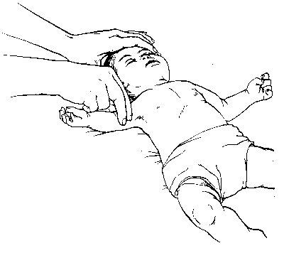
Pulse Check
Brachial in an infant & carotid or
femoral in a child
Take no more than 10 s
Profound bradycardia [PR < 60 bpm + signs of poor perfusion (i.e., pallor, cyanosis)] despite oxygenation & ventilation: chest compressions

Slide 8
Cardiac arrest
عدم پاسخ به تحریکات دردناک
رنگ پریده یا سیانوتیک
بدون تنفس
نبض غیر قابل لمس

Slide 9
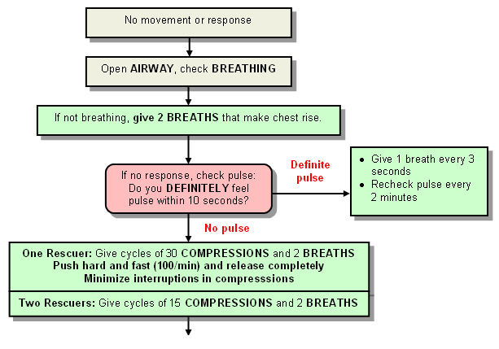

Slide 10
علت های ایست قلبی در کودکان
ندرتا :
اختلال عروق کرنر و آریتمی
اغلب:
آسفکسی
اسیدوز
حوادث
مسمومیت ها
نارسایی قلبی

Slide 11
موفق CPR
جریان خون مناسب
فشار نبض مناسب

Slide 12
Chest Compressions
Compress the lower half of the sternum.
Do not compress over the xiphoid.

Slide 13
Push hard
Push fast
Chest recoil
No interruption
دادن تنفس
بررسی نبض
شوک

Slide 14
Circulation
Adequate compression rate
  (100 compression per minute)
Adequate compression depth
  (One third or one half of the anterior-posterior)

Slide 15
کودک بدون نبض
دو بار تنفس موثر
بدون نبض
بالای یک سال
زیر یک سال
با یک دست یا دو دست
با دو انگشت
استفاده از تخته احیا

Slide 16
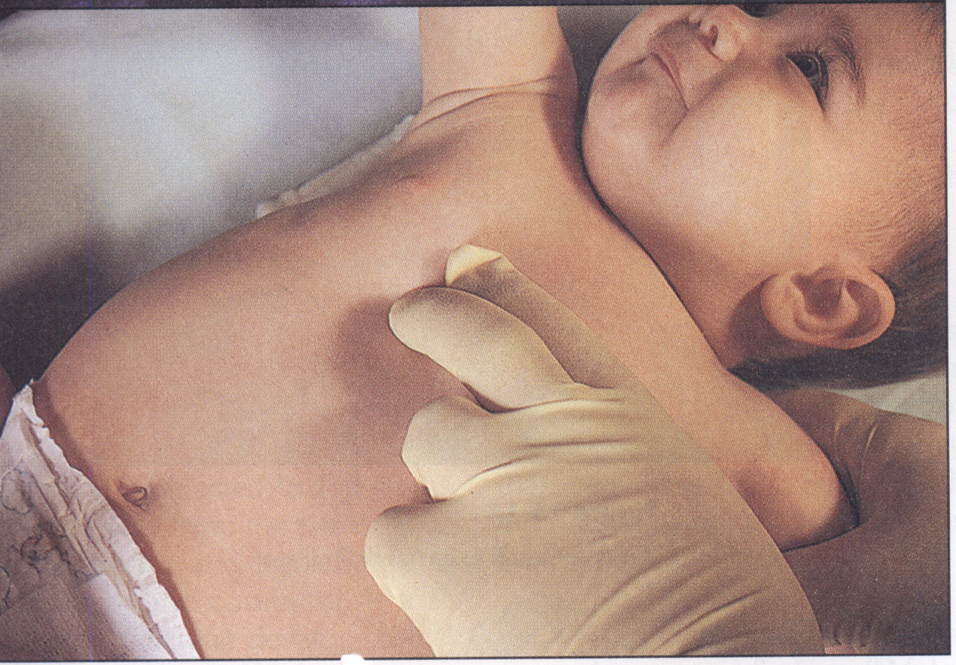

Slide 17
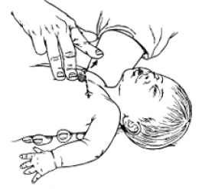
Cardiac compression

Slide 18
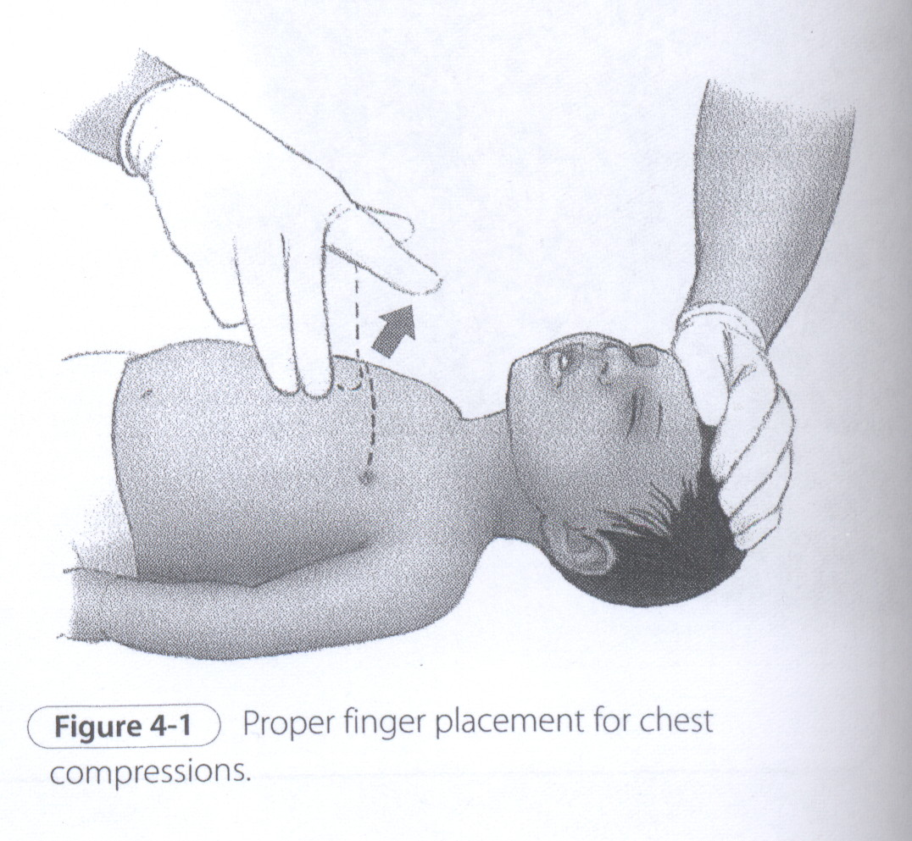

Slide 19
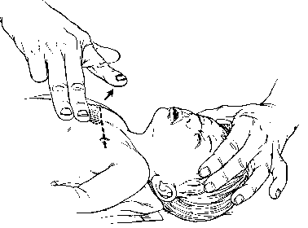
2-finger Chest Compression Technique in Infant
For lay rescuers & lone rescuers
Place 2 fingers just below the inter-mammary line.

Slide 20
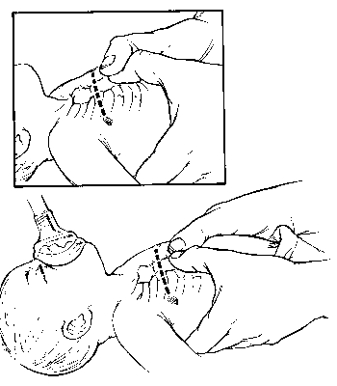
Hand Position for Chest Encirclement
Encircle the infant’s chest with both hands; spread your fingers around the thorax, & place your thumbs together over the lower half of the sternum.
Forcefully compress the sternum with your thumbs .
Notes:
The 2-thumb–encircling hands technique is preferred over the 2-finger technique because it produces higher coronary artery perfusion pressure, results more consistently in appropriate depth or force of compression,and may generate higher systolic and diastolic pressures

Slide 21
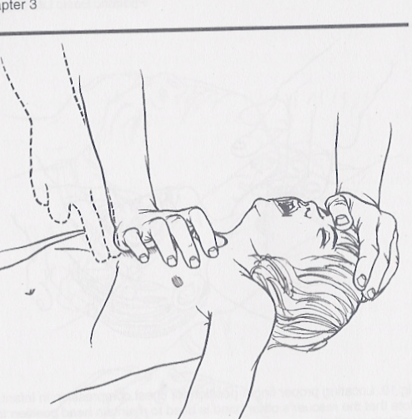
Chest Compressions
In older children → the lower third of the sternum
Maintain continuous head tilt with hand on forehead
One hand
100/minute
1/3 of chest
Carotid pulse is used to check for pulse

Slide 22
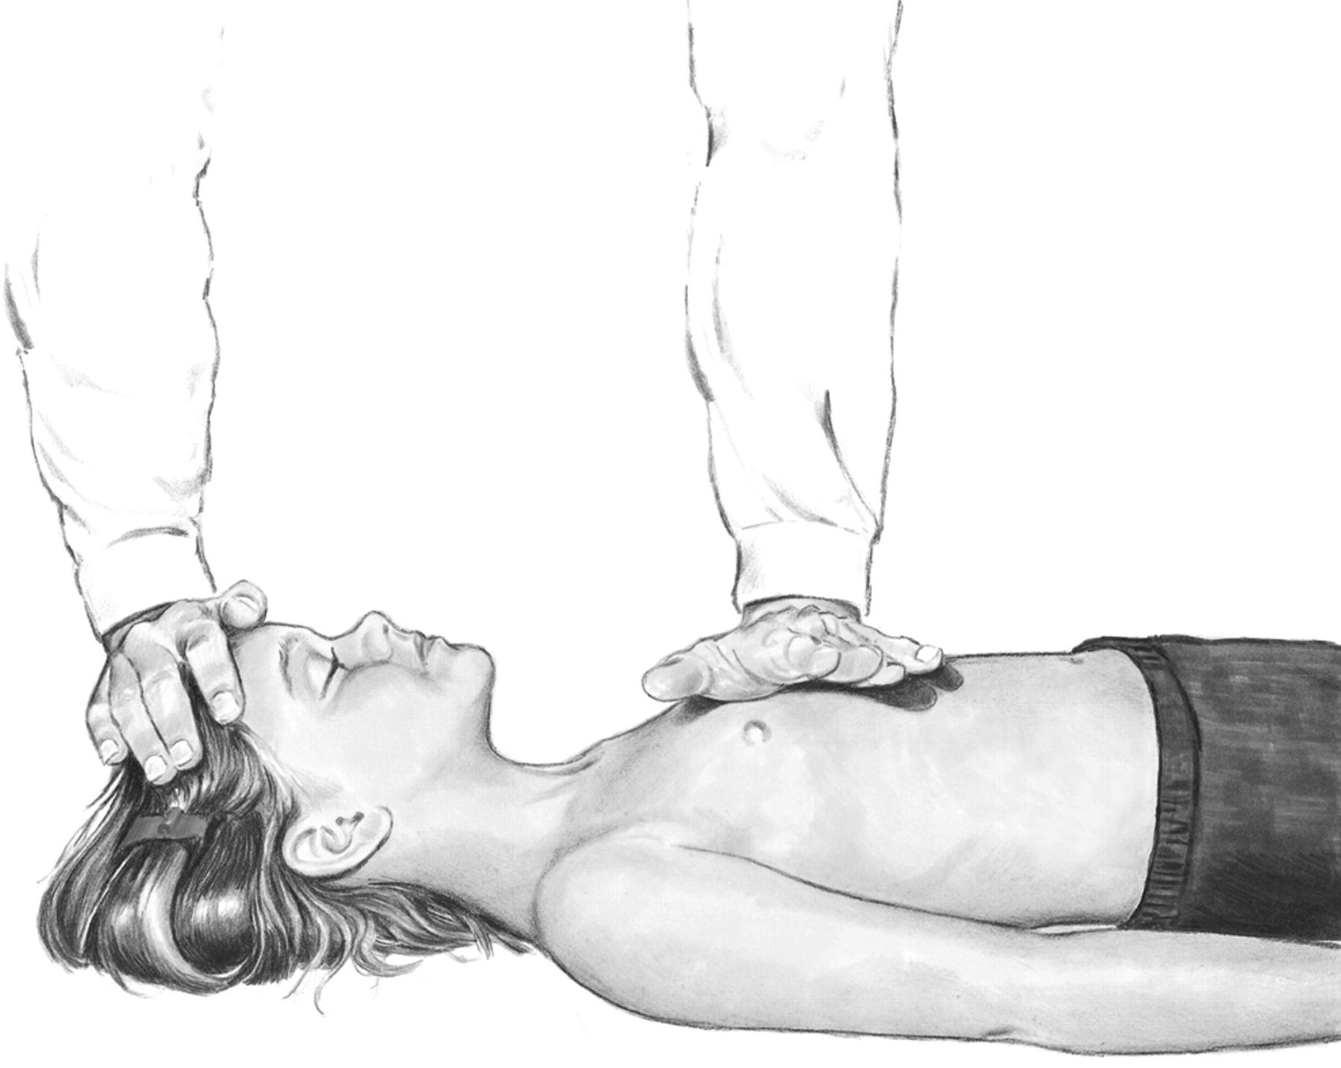
One-hand chest compression technique in child (1-8) Yr
Copyright ©2000 American Heart Association

Slide 23
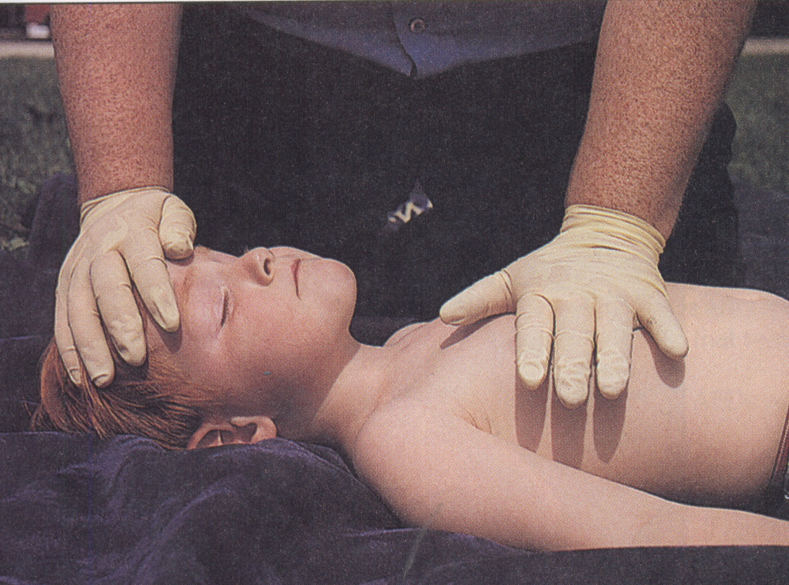

Slide 24
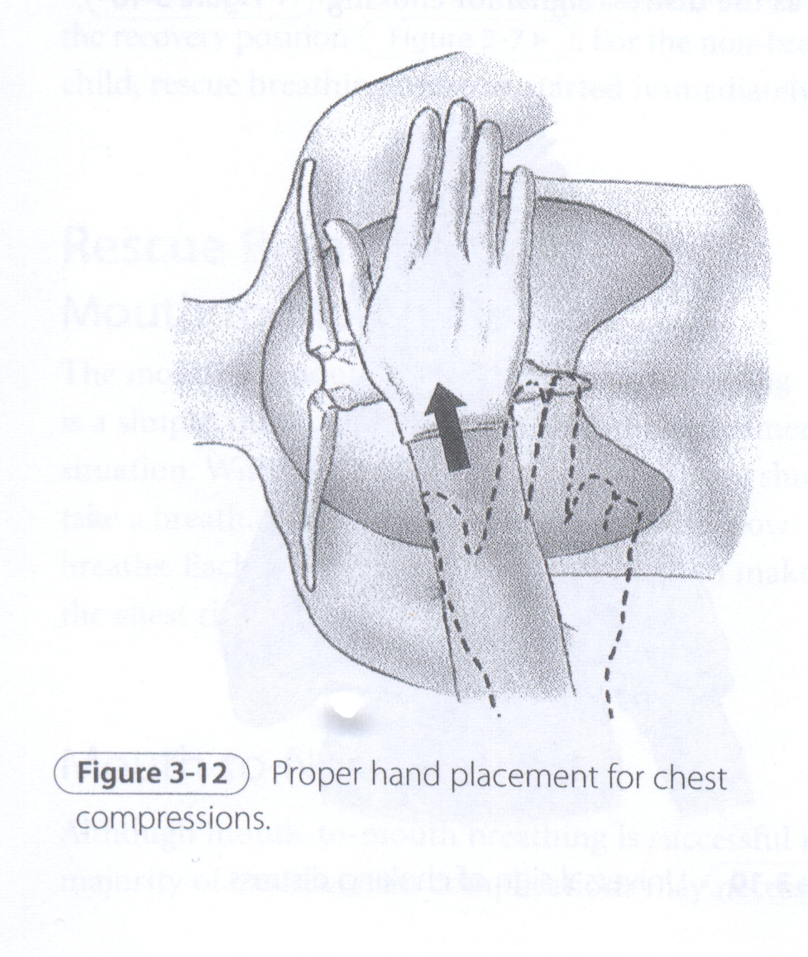

Slide 25
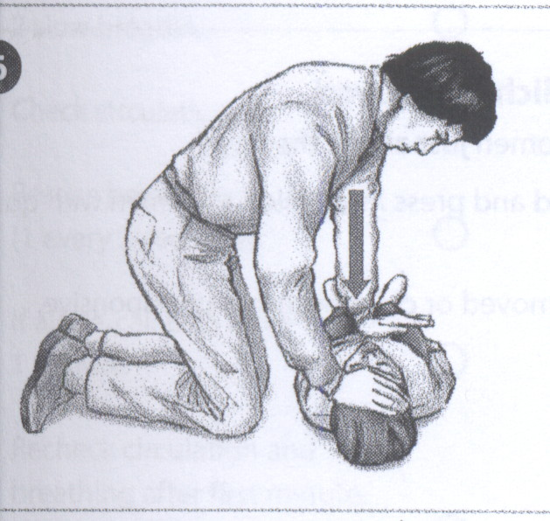

Slide 26
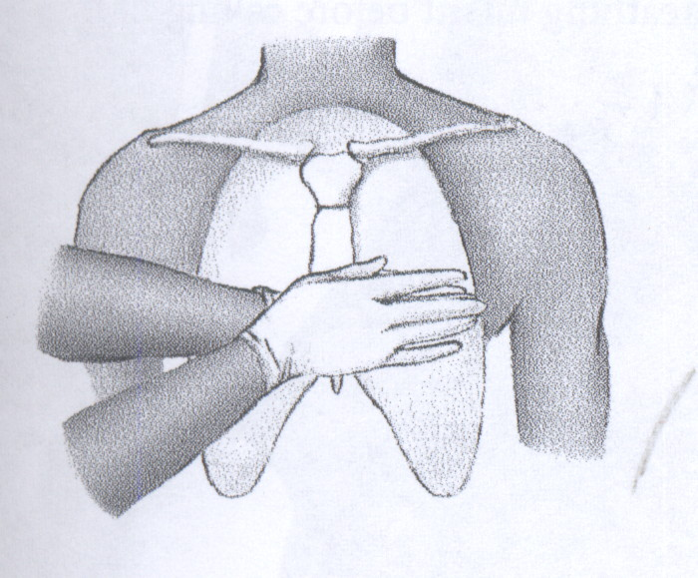

Slide 27
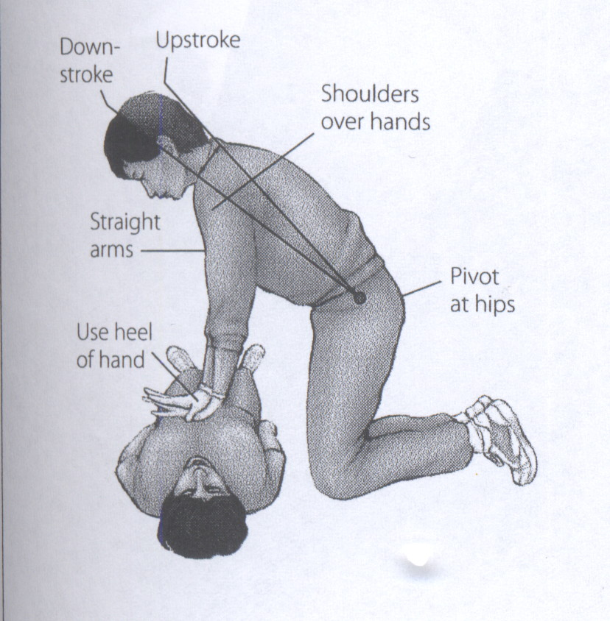

Slide 28
All rescuers acting alone should use a 30:2 ratio of compressions-to-ventilations for all victims except newborns.
Health-care providers performing two-rescuer CPR for infants and children should use a 15:2 compression-to-ventilation ratio when there is no advanced airway in place.

Slide 29
Once an advanced airway is in place, continuous chest compressions are given at 100/minute with one ventilation every six to eight seconds (8–10 ventilations per minute). The ventilations are given without pausing chest compressions.

Slide 30


